Slide 1


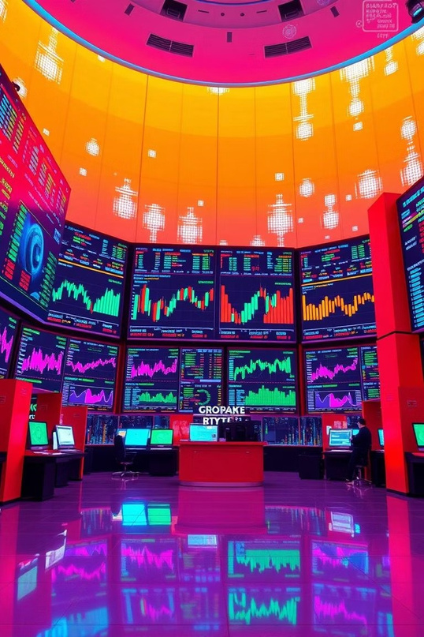
Revolutionizing Stock Price Prediction with LSTMs
Leveraging deep learning to navigate volatile markets. Improving forecasting accuracy with advanced models like LSTM.

Slide 2




The Challenge of Stock Price Prediction
Market Volatility
Stock prices are inherently volatile and non-linear, complicating predictions.
Model Limitations
Traditional econometric models often fail to capture complex market patterns.
Need for Innovation
Advanced techniques are essential to better model temporal dependencies.

Slide 3
Limitations of Traditional Models
ARIMA Models
GARCH Models
Struggle with non-linear stock price dynamics Limited long-term dependency capture
Focus mostly on volatility forecasting Insufficient for price level prediction

Slide 4
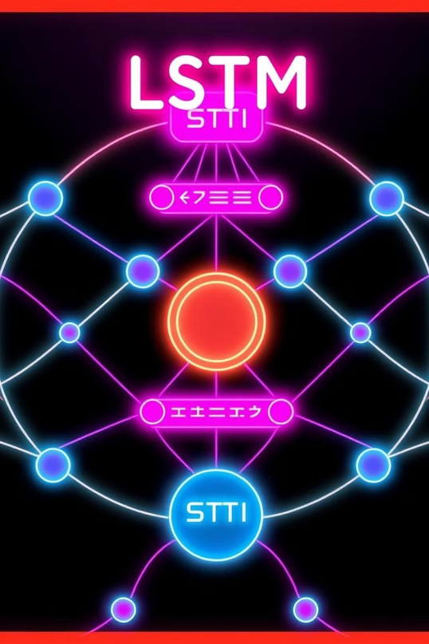



LSTM Networks: A Deep Learning Solution
Recurrent Neural Ne t wo rk
Captures sequential patterns and temporal dependencies effectively.
Long-Term Learning
Designed to overcome vanishing gradients, enables long sequence memory.
Better Predictions
Excels in modeling complex, non-linear stock price movements.

Slide 5
LSTM Architecture for Stock Prediction
Inputs
Historical prices, market data, and technical indicators.
LSTM Layers
Process sequences, extract features, learn temporal relations.
Output
Next period predicted stock prices via backpropagation through time.

Slide 6
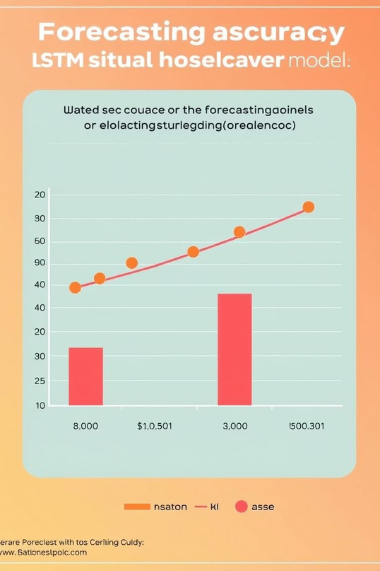


Results: Enhanced Accuracy and Performance
Improved Accuracy
LSTM models outperform ARIMA and GARCH by 15-20% on key metrics.
Extensive Testing
Validated on S&P 500 and NASDAQ stocks from 2010 to 2023.
Performance Metrics
Measured by MAE and RMSE for reliable evaluation.

Slide 7
Evaluation Metrics
Mean Absolute Error (MAE)
Average absolute prediction error magnitude.
Root Mean Squared Error (RMSE)
Measures squared error magnitudes, emphasizing larger errors.
R-squared
Proportion variance explained; LSTM achieved 0.85-0.90.

Slide 8


Conclusion: The Future of Financial Forecasting
Promise of LSTM
Advanced models improve accuracy in volatile markets.
1
2
Integration Potential
Can combine with alternative data for richer insights.
3
Future Research
Focus on model robustness and interpretability enhancements.

